Slide 1





Software Engineering Practice
————————
Yao Jinru 202283890008
Yao Yao 202283890009
Zhang Yuchen 202283890014
DATE: 2026.1.13
Reporter:

Slide 2




01 Introduction
02 Agile Process
03 Point-of-Sale system
04 Achievement Showcase

Slide 3





Introduction

Slide 4




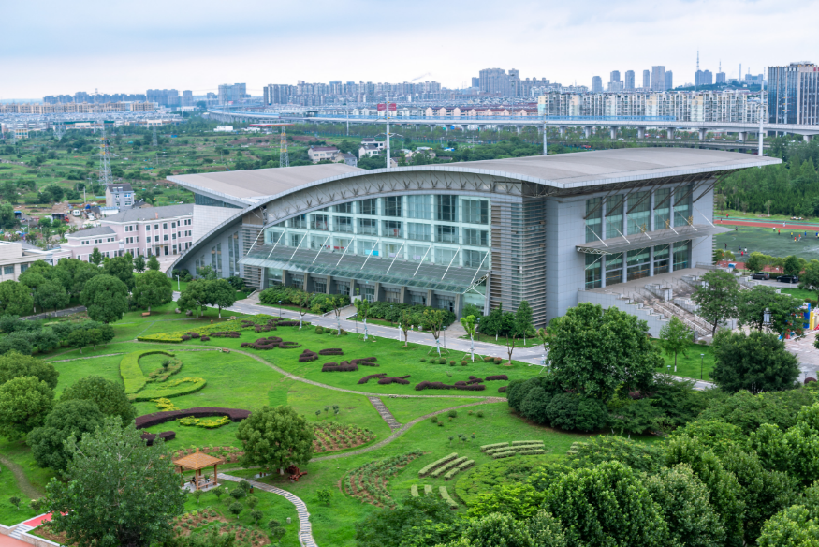
Introduction
This project employs an agile development approach based on the Scrum framework to build a simplified supermarket checkout system tailored for small retail scenarios.
The system comprises three core functions:
During checkout, cashiers input product codes, and the system instantly Displays Items and Totals.
For cash payments, it automatically verifies funds, calculates change, and Deducts Inventory.
For returns, entering items and quantities triggers refunds and Restores Inventory.
Users can also Query Current Stock Levels for all products at any time.
All inventory data updates instantly after transactions or returns are completed, ensuring accurate and consistent information.

Slide 5
Agile Process

Slide 6


Agile Framework
Processes:
The system comprises three processes: sales, returns, and inventory inquiries. During sales, cashiers enter product codes, and the system displays items and totals, calculates change, and deducts inventory. For returns, staff input items and quantities, and the system issues refunds while replenishing inventory. Users can view current stock levels for all products at any time, with inventory updating immediately after transactions or returns.
Principles:
Development follows an iterative approach, with features broken down into smaller chunks and completed incrementally. The team maintains clear roles and consistent communication. Each module undergoes testing upon completion, with issues addressed promptly. High-value features like cashier operations and inventory synchronization are prioritized. Each phase has a fixed timeline that cannot be extended.
Tools:
Write code with PyCharm, manage versions and collaborate with GitHub, assign tasks and create burn-down charts in Excel, write reports in Word, and publish presentation videos on Bilibili.

Slide 7


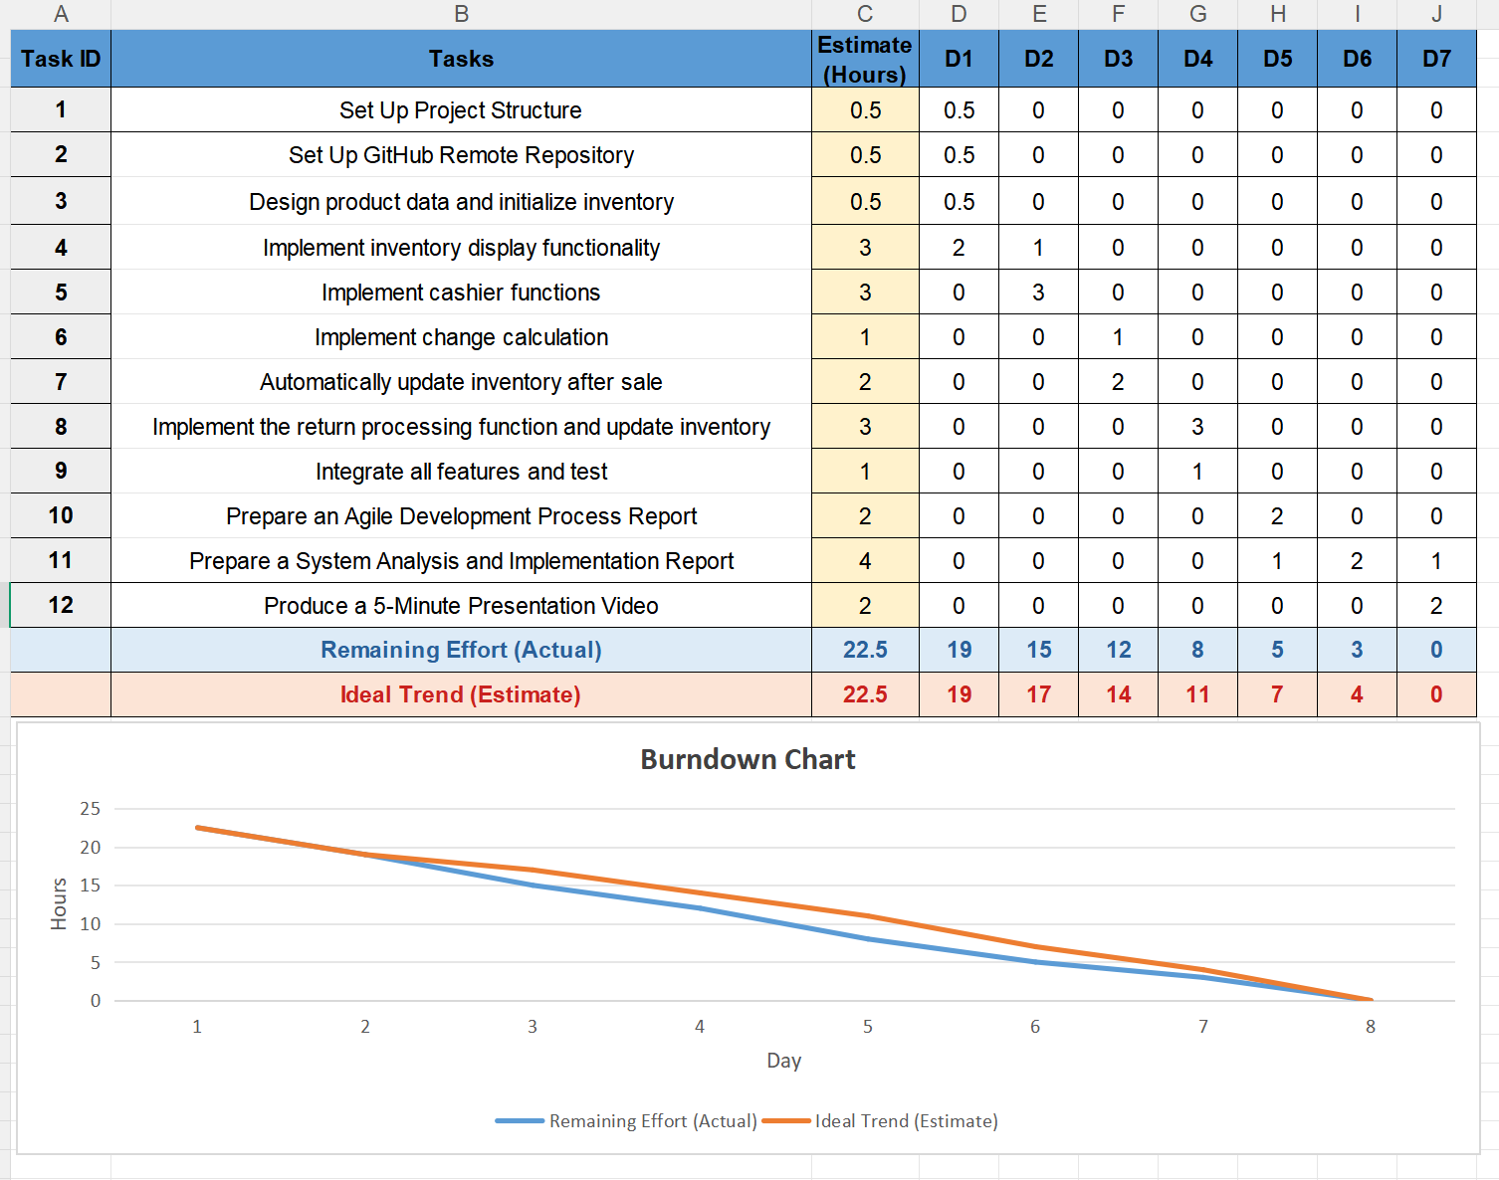
Agile Framework
Sprint 1:
Over the course of two days, the primary tasks will be completing the project structure setup, initializing product data, and implementing inventory viewing functionality.
Sprint 2:
A two-day program focused on implementing core business functions such as sales processing, returns operations, and real-time inventory updates.
Sprint 3:
Over the course of three days, we will focus on completing the agile process report, drafting the system implementation documentation, and producing a five-minute demonstration video.

Slide 8
Point-of-Sale system

Slide 9


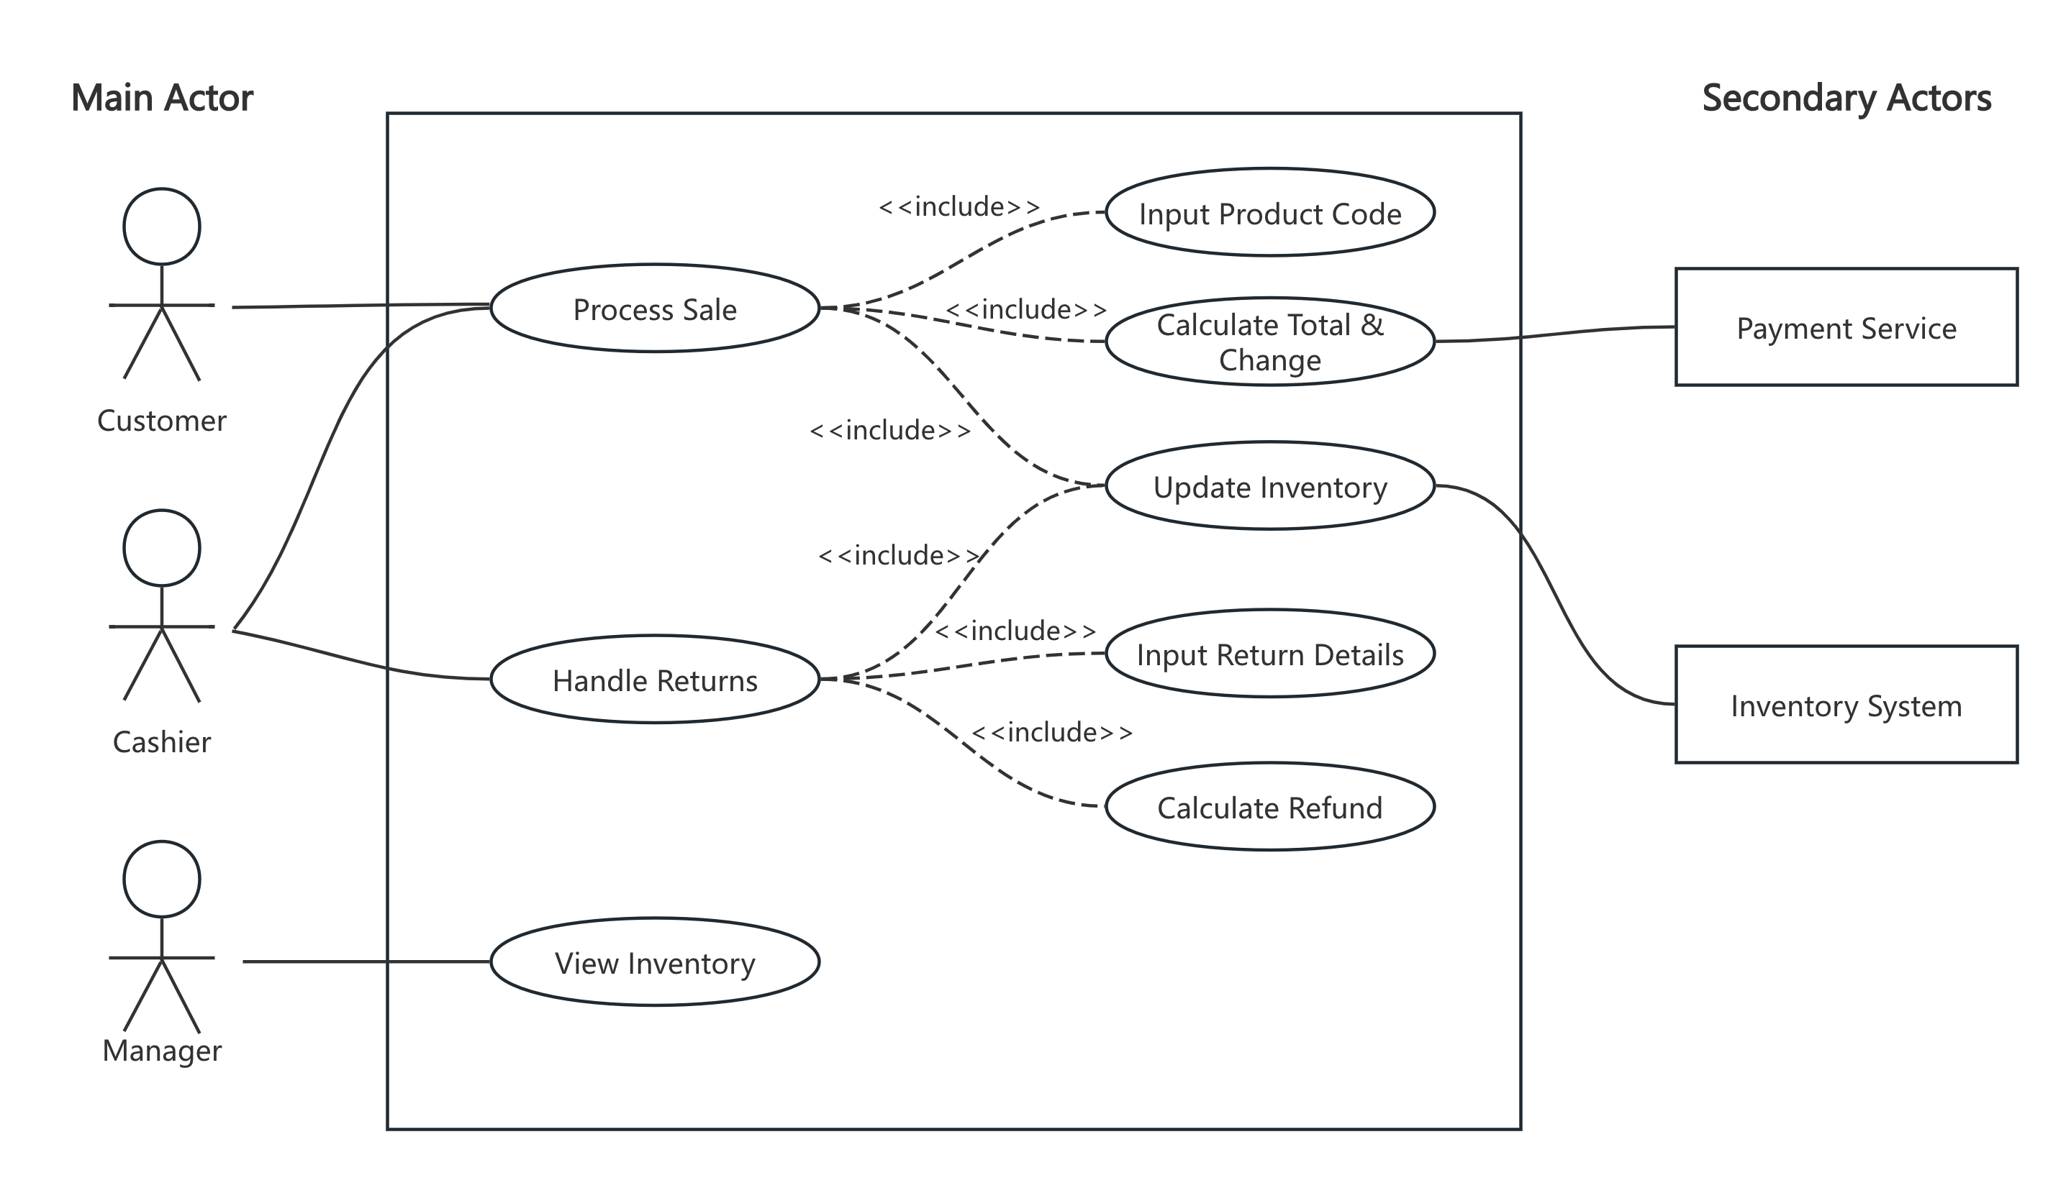
Overview of System Use Case Models
Actors:
Main Actor：Customer, Cashier, Manager
Secondary Actor：Payment Service, Inventory System
System Functions:
Process Sale
Handle Returns
View Inventory
Key Relationship Points
Primary participants interact with the system through core functionalities
Secondary participants provide external services/information (payments, stock enquiries/updates)

Slide 10
Sales Process Use Case
Participant Trigger Point
Cashier initiates new sale
Primary Process
Cashier enters each sold item individually
System invokes SaleService (business logic layer)
SaleService triggers Product.update_stock, deducting stock in real time
Continues collecting item information until completion
Transaction completed
The system verifies the payment amount; if sufficient funds are available, the transaction is finalised
Inventory and sales records are synchronised and updated, generating a receipt/transaction voucher

Slide 11
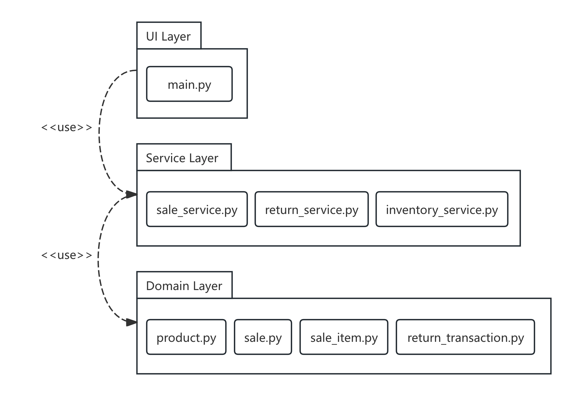
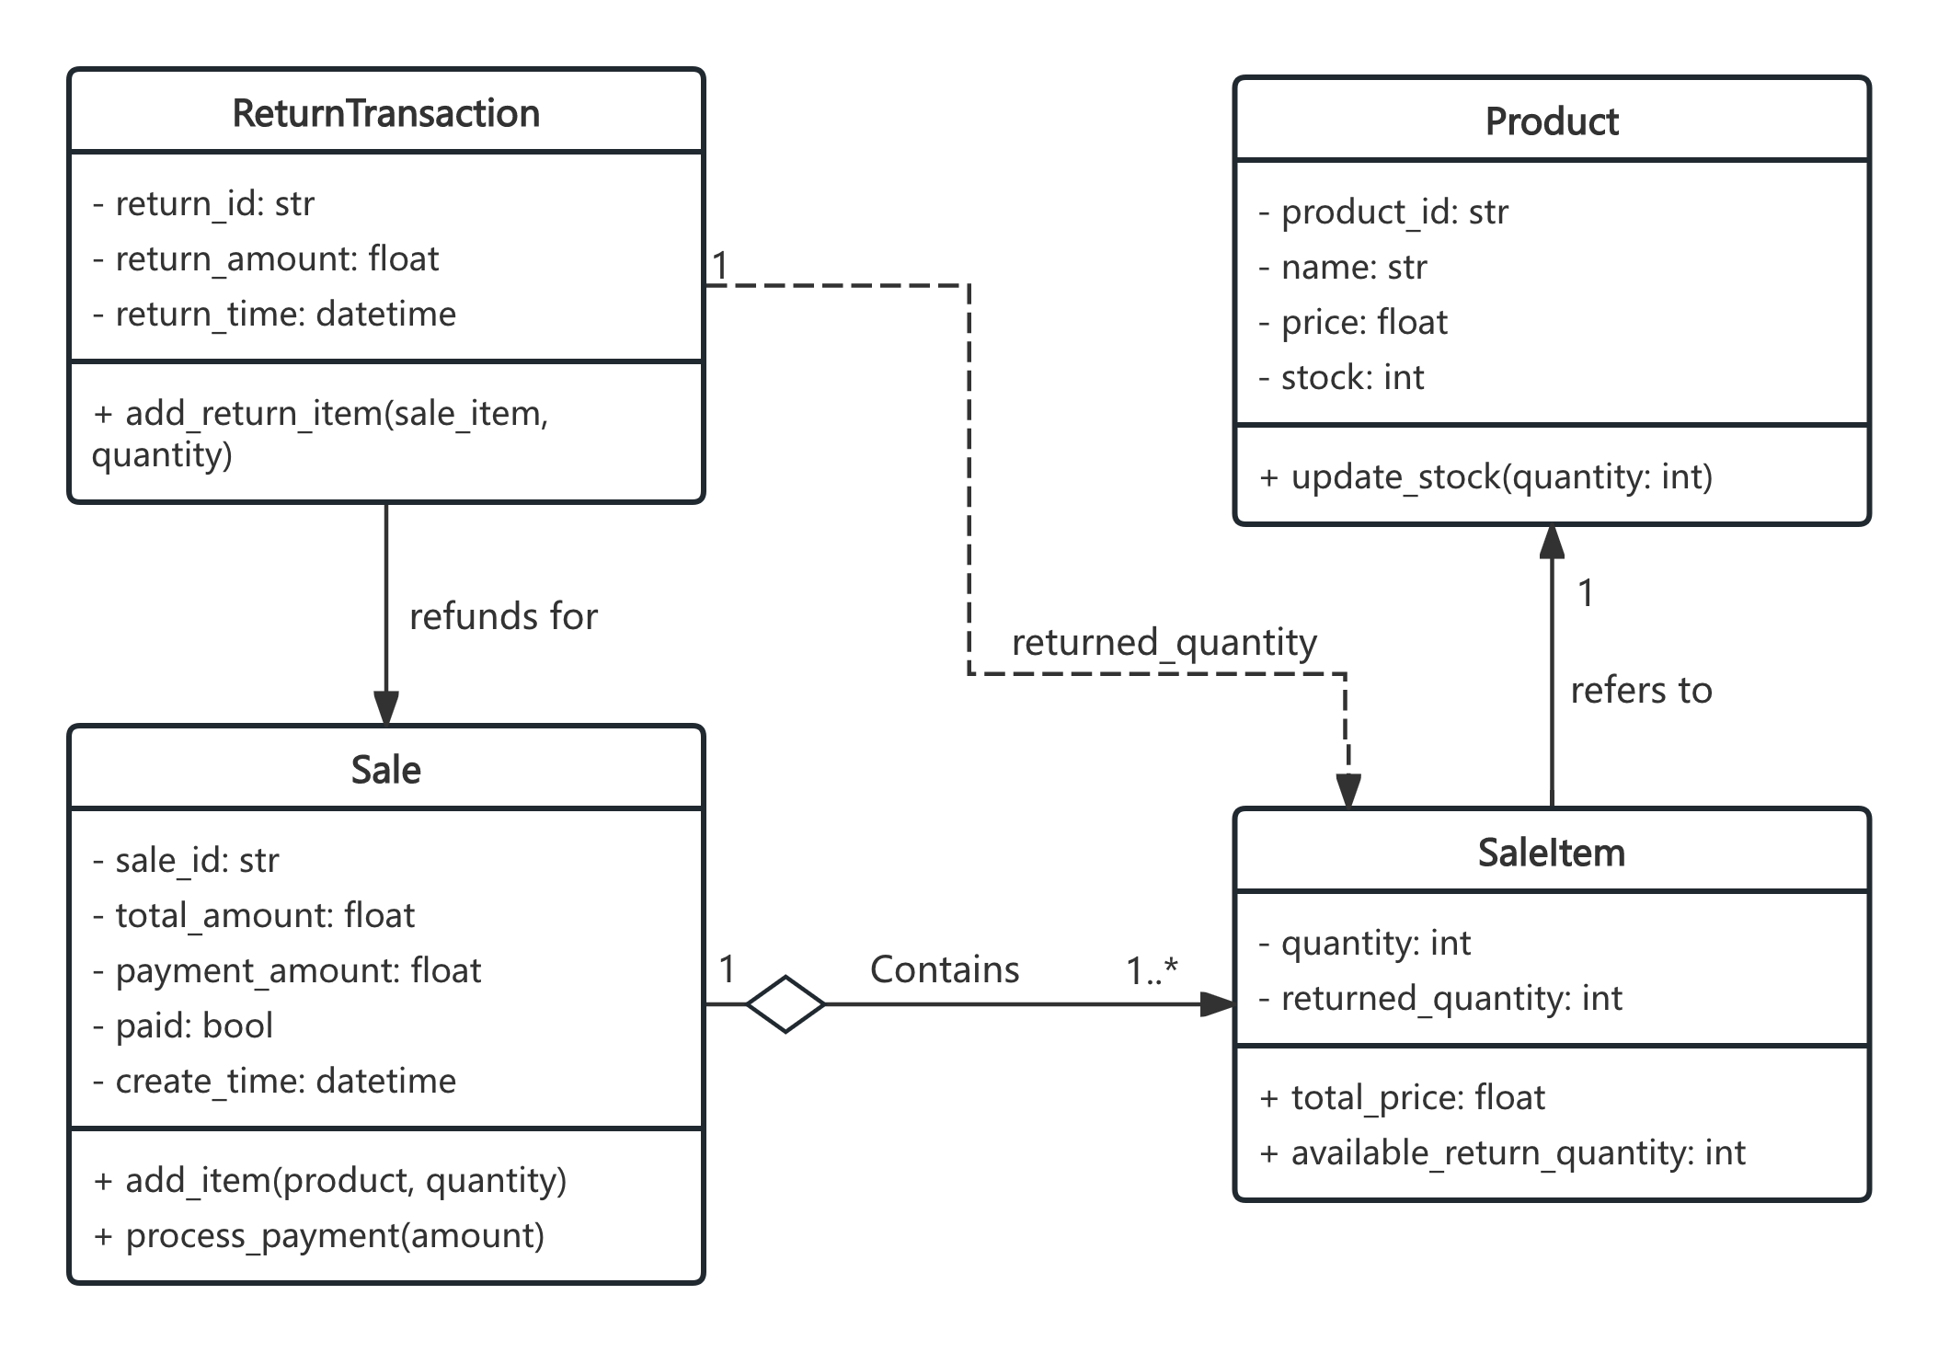
Logical Architecture
—— UML Package Diagram
—— UML Class Diagram

Slide 12
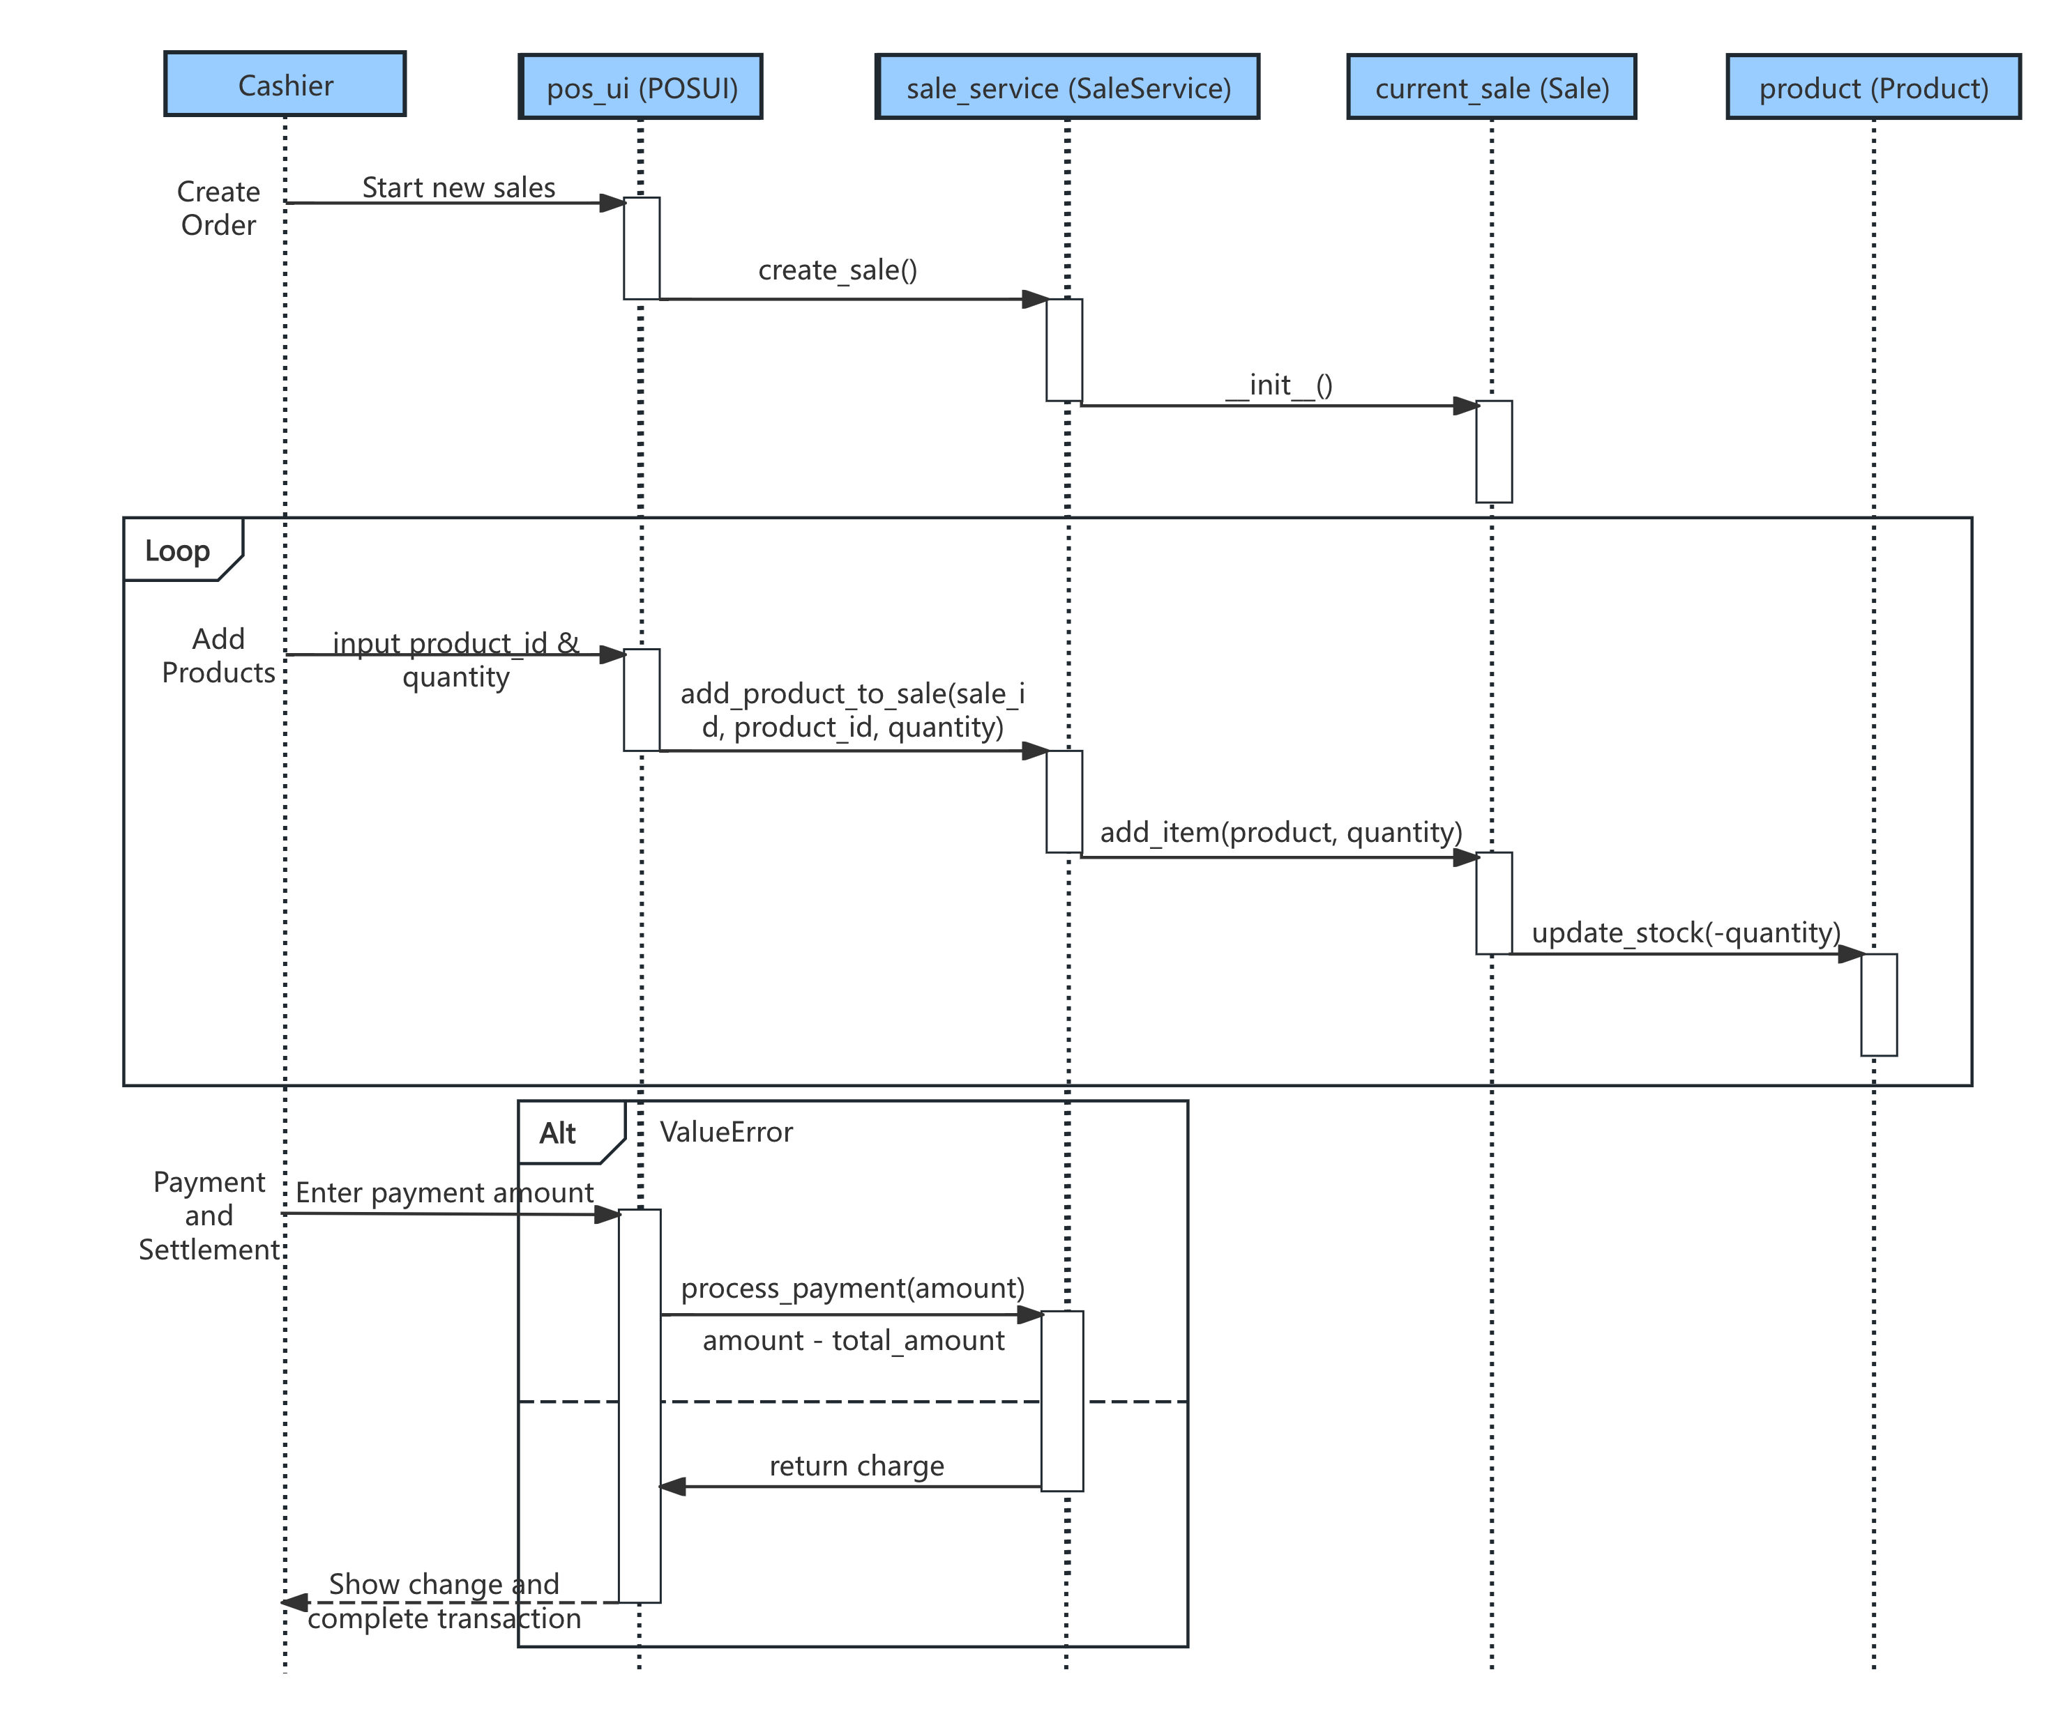
Sale Process Sequence
Participants and Systems: Cashier, POS UI, SaleService, current_sale, Product, SaleItem/Inventory Interactions between systems
Primary Workflow:
Cashier creates a new sales order (Create Sale/Start New Sales)
POS UI passes input to SaleService, which initiates the new sale (create_sale() / init)
The product object in the Domain layer updates inventory via SaleItem, calling update_stock(quantity) to deduct stock in real time
Loop to add products (Add Products) until sale concludes
Payment phase: Process payment amount, validate whether total_amount is sufficient
Exception/Boundary:
When payment is insufficient, a ValueError is raised and propagated, displaying an error message/signal.

Slide 13
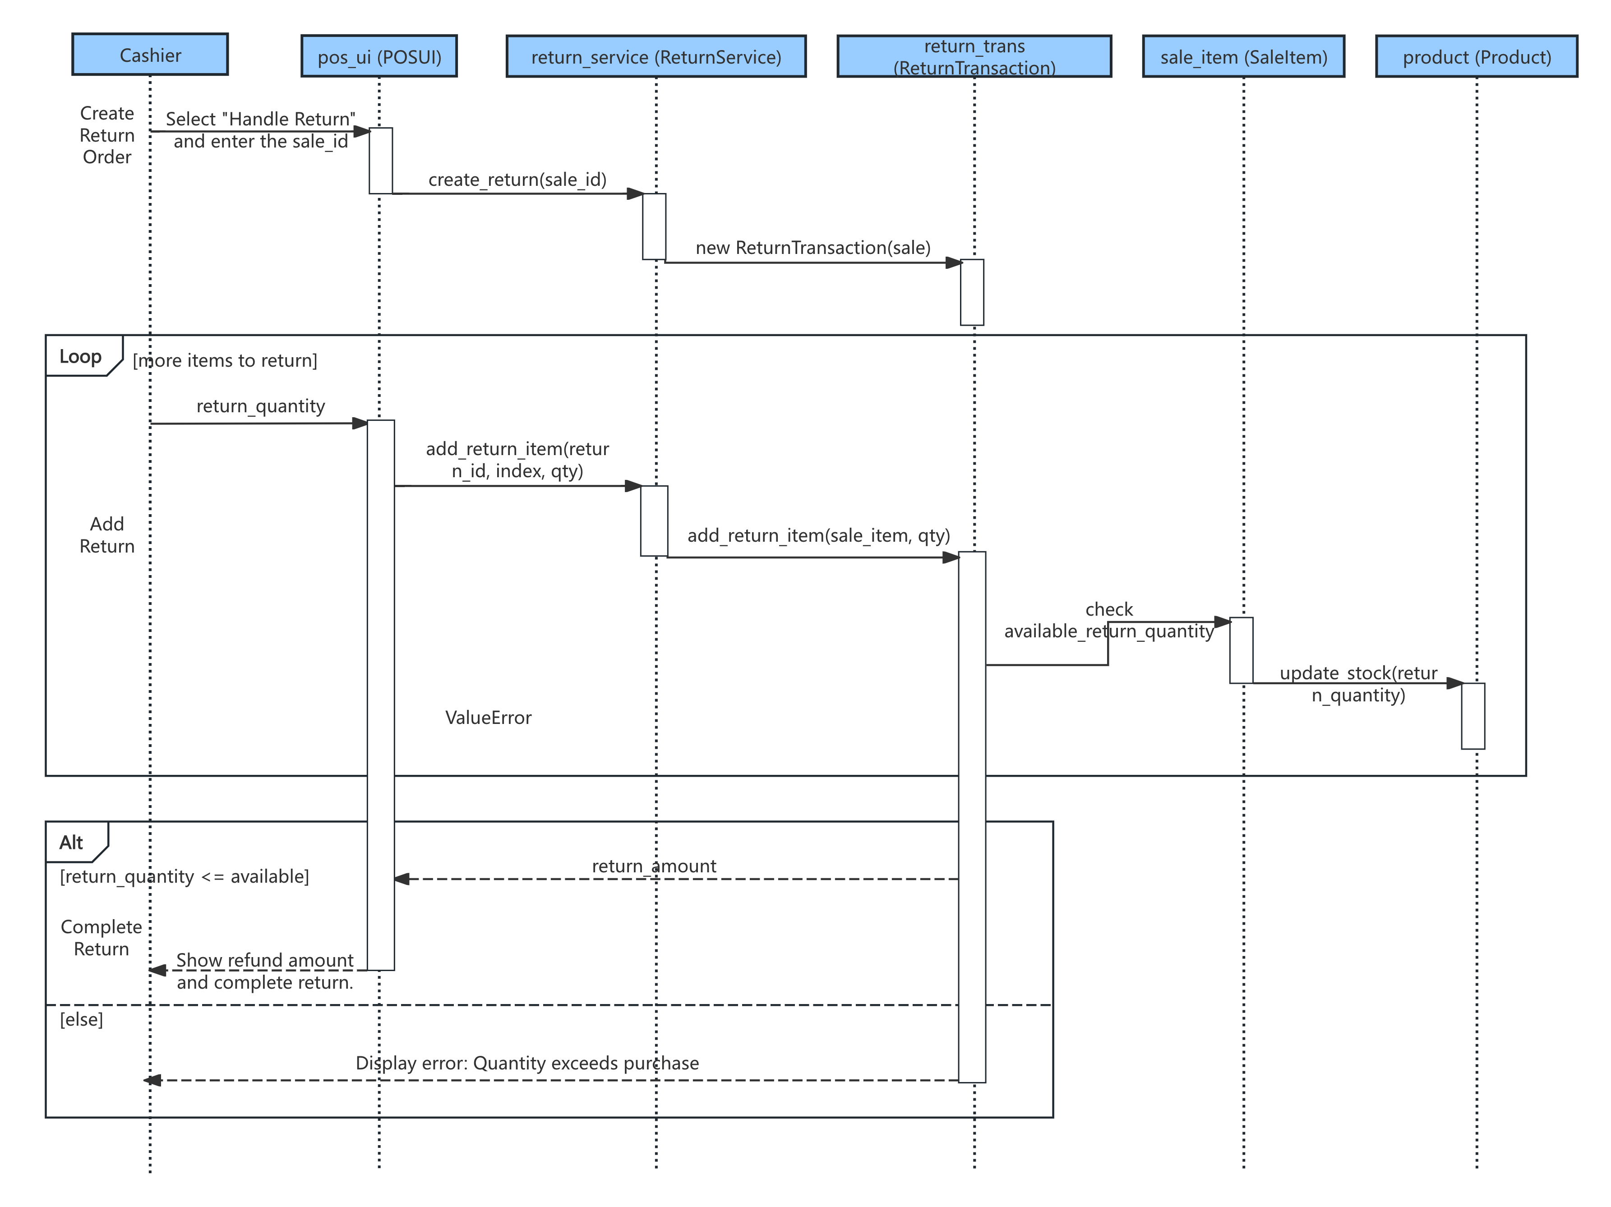
Return Process Sequence
Participants and Systems: Cashier、POS UI、ReturnService、ReturnTransaction、SaleItem、Product
Primary Workflow:
Cashier creates a return order (Create Return Order)
POS UI selects "Handle Return" and enters sale_id, triggering create_return(sale_id)
ReturnService enters, creating a new ReturnTransaction (new ReturnTransaction(sale))
Loops to add return entries (Add Return), performing item-by-item validation and stock adjustments
Validates return quantity: check available_return_quantity
Update stock: update_stock(return_quantity)
Return result: display balance/refund amount, prompt for error if necessary
Exception/Boundary:
If the quantity returned exceeds the allowable return quantity, an error is displayed and the process is terminated (ValueError or a custom exception).

Slide 14
Achievement Showcase

